Slide 1
CS2040 Lab#04 B03 (Please set up your camera for Visualgo quiz) 14/9/2020

Slide 2
Some feedbacks

Slide 3
Feedbacks
Please write some necessary comments in your code.
Clarify the pre/post conditions of your methods.
Demonstrate your thoughts about why the method works / what to ensure before / what can be guaranteed after.
E.g. In Feeding Frenzy, your methods work because the sizes of the fish are already sorted in order.

Slide 4
CS2040 Lab #03
Qn1. Window

Slide 5
Problem Breakdown:
Input:
2 Integers: Number of elements (N) and window size (K)
Sequence with N integers
Output:
N - K + 1 Integers : each representing the ID of the left most odd element of each window.

Slide 6
Approach:
Data Structure:
Array or ArrayList (Some sort of collections)
To store the input sequence
Queue
To represent sliding window
However, do not have to store EVERY element in it, store the index of odd elements to improve efficiency
Should always have a size not more than K (the window size)
Algorithm:
Loop through N - K + 1 times, using some comparison with the looping variable to update the queue.
If queue is empty for a specific window, means no odd elements in it

Slide 7
Example
ID: 1 2 3 4 5 6 7
Num: 1 2 3 5 4 10 8
N = 7, K = 3
[window content] (Num) → [queue] (ID)→ output
[1, 2, 3] → [1, 3] → output : 1
[2, 3, 5] → [3, 4] → output : 3
[3, 5, 4] → [3, 4] → output : 3
[5, 4, 10] → [4] → output : 4
[4, 10, 8] → [ ] → output : -1

Slide 8
CS2040 Lab #03
Qn2. Feeding Frenzy

Slide 9

PROBLEM
Initially, there are n full fishes in the pond, represented by their integer size
m hungry fishes enter the pond, sequentially.
Each time a hungry fish enters, it eats all the fish that are strictly smaller than itself and its size increase by the eaten fish’s size
It will become full once it finished eating all (strictly) smaller fishes
Next fish will then be added (once current hungry fish becomes full)

Slide 10
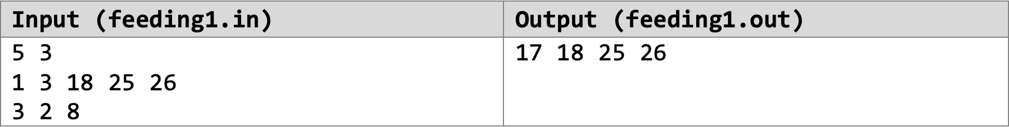
SAMPLE TEST CASE
There are 3 hungry fishes that will be placed in the pond
Output remaining full fishes in the pond, listed in ascending order
There are 5 full fishes in the pond, initially
List of full fishes in the pond initially, listed in ascending order
List of hungry fishes that will be placed in the pond sequentially

Slide 11
Sequence:
Initially, the five fishes in the pond are all full: 1 3 18 25 26
Next comes a hungry fish of size 3 into the pond
It then eats a fish of size 1. It now has size 3 + 1 = 4
It then eats a fish of size 3. It now has size 4 + 3 = 7
It can no longer eat any fish in the pond, so it becomes a full fish.
Next comes a hungry fish of size 2
It can’t eat any fish, so it just becomes a full fish.
Next comes a hungry fish of size 8
It then eats a fish of size 2. It now has size 8 + 2 = 10
It then eats a fish of size 7. It now has size 10 + 7 = 17
It can no longer eat any fish in the pond, so it becomes a full fish.
Full fishes remaining: 3 18 25 26
Full fishes remaining: 18 25 26
Full fishes remaining: 7 18 25 26
Full fishes remaining: 2 7 18 25 26
Full fishes remaining: 7 18 25 26
Full fishes remaining: 18 25 26
Full fishes remaining: 17 18 25 26

Slide 12
DATA STRUCTURES
Allowed:
Java Queue API / Java LinkedList API
Java Stack API
Self-Implemented Stack / Queue (must behave like one!)
Other Data Structures are strictly forbidden
That means Heaps (PriorityQueue) are not allowed!

Slide 13
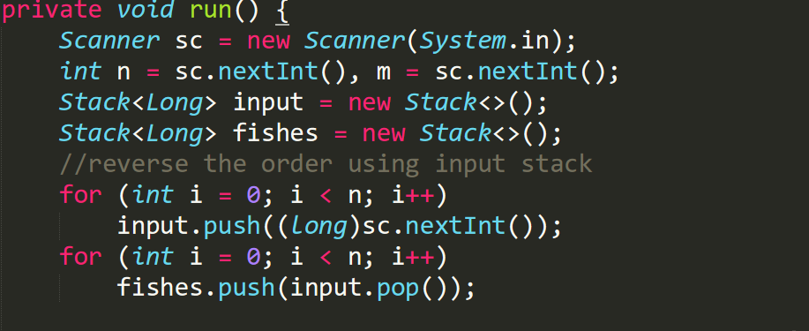
Solution

Slide 14
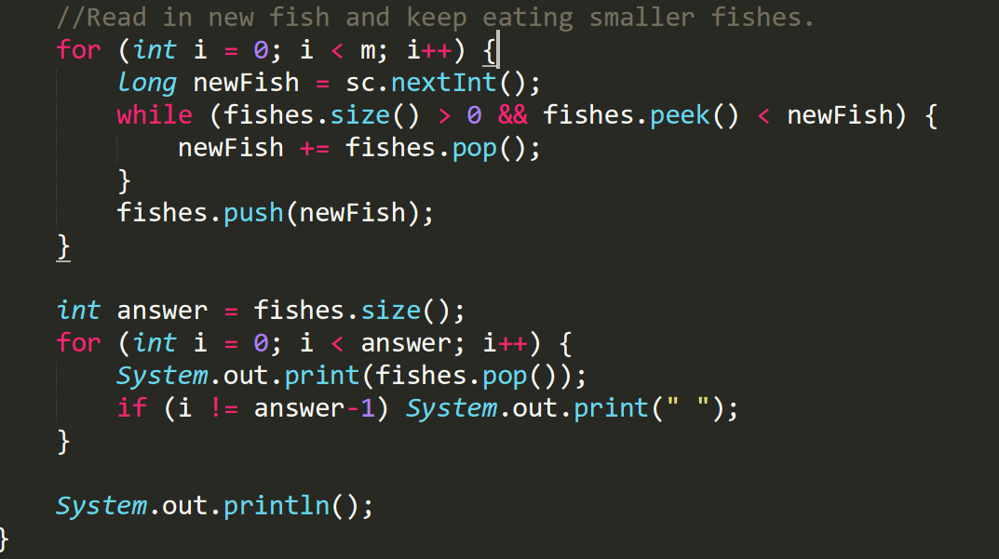
Solution

Slide 15
Visualgo quiz

Slide 16
Visualgo quiz
18 questions in 10 minutes
Make sure you record the right screen
Upload your recording to TG group after the quiz,
and name your video as NAME+MATRIC NUMBER+ SCORE
https://visualgo.net/training?diff=hard&n=15&tl=10&module=linkedlist

Slide 17
Mock midterm (15 mins)

Slide 18
Mock midterm
1. Zoom Video is on (turn on one video) & Zoom Mic is muted
2. Virtual background is not used on Zoom
3. Headphones are not allowed
4. Change the file name to your NUSNET ID.
4. After the release of the password, only read the 2 green pages. you are NOT supposed to scroll down to the questions until you are given permission to do so
5. During exam, screen capture MUST capture you whole screen and not just 1 window

Slide 19
CS2040 Lab #04
Qn1. Palindrome

Slide 20
Introduction
You are given a string of n <= 20 characters. Determine if you can turn the string into a palindrome by deleting at most k <= 6 characters.
A string is a palindrome iff s[i] == s[n-i-1] for all i<n
Strategy: start from the outermost letters. If they match, move inwards. Otherwise, remove either the one at the left or the right. If you don’t run out of deletions, you’ll meet in the center.
Use recursive function which returns a boolean

Slide 21
CS2040 Lab #04
Qn2. Movies

Slide 22
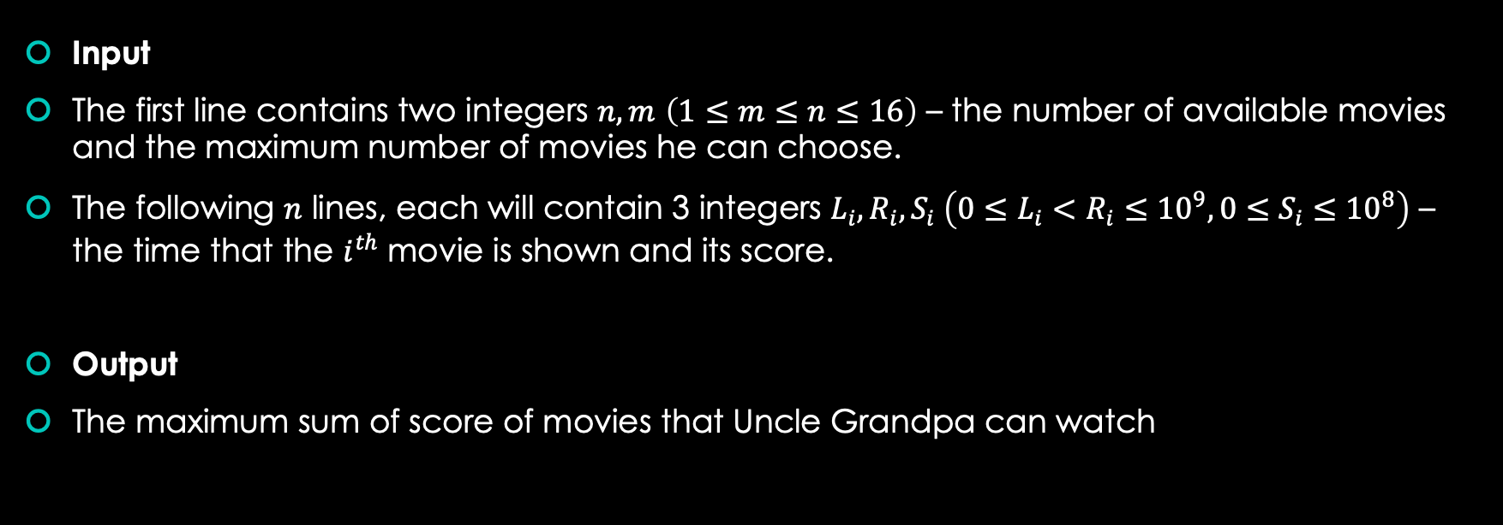
Problem statement

Slide 23
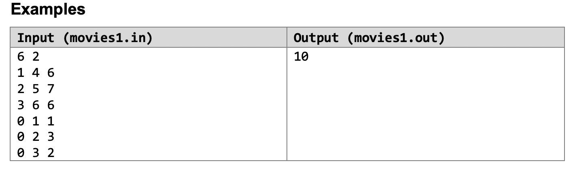
Problem statement
Explanation:
In this example, the way with the highest score is to choose the 2nd movie (starts at 2, ends at 5 and has a score of 7) and the 5th movie(starts at 0, ends at 2 and has a score of 3).

Slide 24
Basic idea: Recursion
For each movie, you choose or not choose. Go through every possible combination of choices.

Slide 25
Recursion
Why we can use this recursion which is not efficient?
Ans: Because the number of movies is only up to 16. Even O(2^n) algorithm can solve the problem in a short time.

Slide 26
Recursion
Possible Data Structures:
1. Array ”boolean[] chosen = new boolean[n]” to store whether ith movies is chosen or not.
2. Movie class: Stores the L time, R time and S score, has a method “intersect” to check whether another movie’s time overlaps with this current movie.

Slide 27
CS2040 Lab #04
Qn3. Jobs

Slide 28
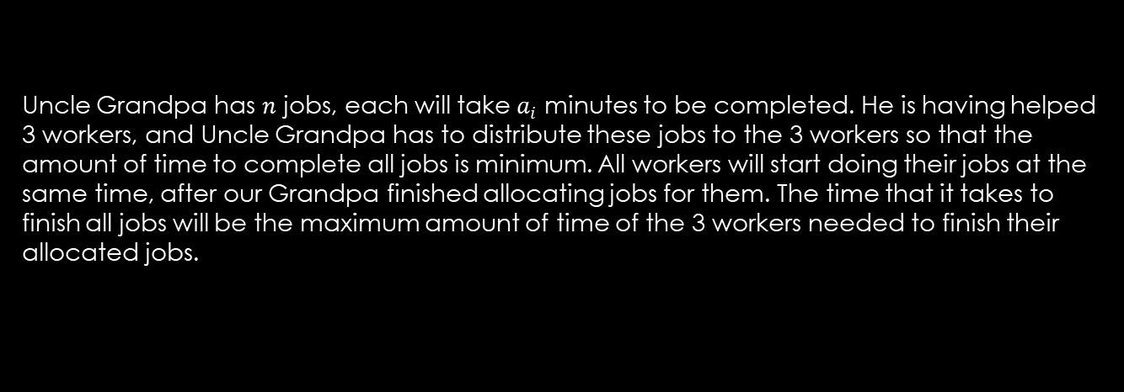
Problem Statement
Uncle Grandpa has $n$ jobs, each will take $a_{i}$ minutes to be completed. He is having helped 3 workers, and Uncle Grandpa has to distribute these jobs to the 3 workers so that the amount of time to complete all jobs is minimum. All workers will start doing their jobs at the same time, after our Grandpa finished allocating jobs for them. The time that it takes to finish all jobs will be the maximum amount of time of the 3 workers needed to finish their allocated jobs.

Slide 29
Problem Statement
n jobs, 3 workers A, B, C
Assign the jobs to the works, each worker has a total working time. i.e. tA = sum(all jobs assigned to A)
return the longest working time max(tA, tB, tC)
try to minimise the longest working time

Slide 30
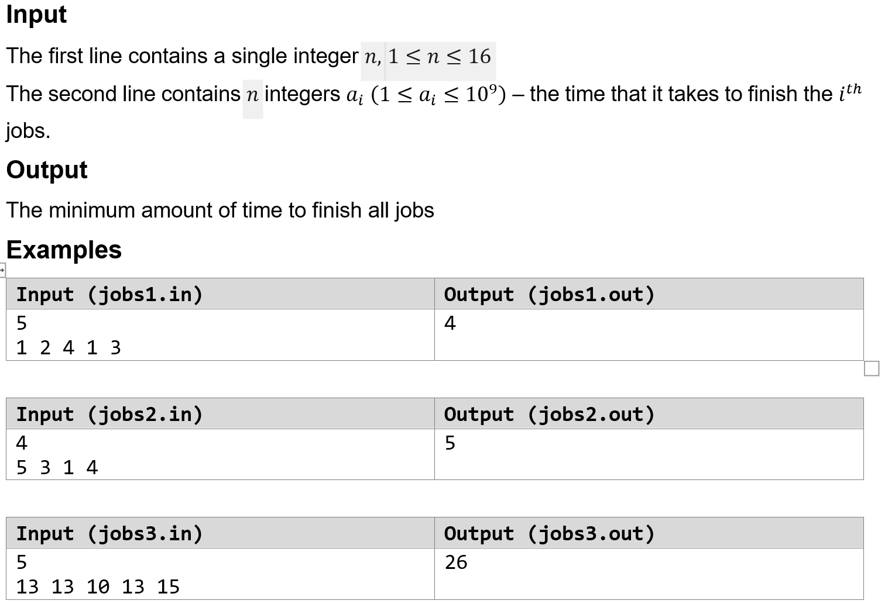
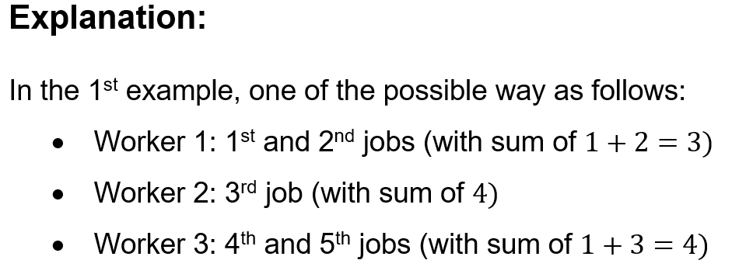
Problem Statement

Slide 31
Design Ideas
1. The working hours can be fairly large => use long instead of int
2. There are many ways to divide the jobs, and we should return the one with minimum value => min(max(tA, tB, tC))
3. Intuitively, we should try to make an even distribution
4. There are only 3 workers, a small constant that we can apply recursion to consider all cases of job division

Slide 32
Data Structure and Algorithm
1. For any state/round of the problem, we have a current job to be allocated, and current working hours of A, B, C (jobs already assigned to them so far)
2. We have 3 choices: to allocate the current job to either A, B, or C
The structure of the problem assembles a tree with 3 children for each node
3. Consider using recursion to traverse the tree for all possible cases

Slide 33
Demonstration

